Slide 1
Proposal Overview
HCI - Enterprise Cloud Proposal for
Rugged Rider Auto
Americas Team 42
April 12, 2018

Slide 2
Proposed Solution
Overview

Slide 3
Requirements description of current environment
Car dealerships and business throughout US West
25 business locations
Growing by 1 dealership per month
Each location requires own central parts ordering application consisting of:
NGINX and HAProxy load balancers
5x new non-persistent users
2x new full clone persistent desktops
Reduce
CAPEX
OPEX
70%+ TCO reduction

Slide 4
Solution Sizing

Slide 5
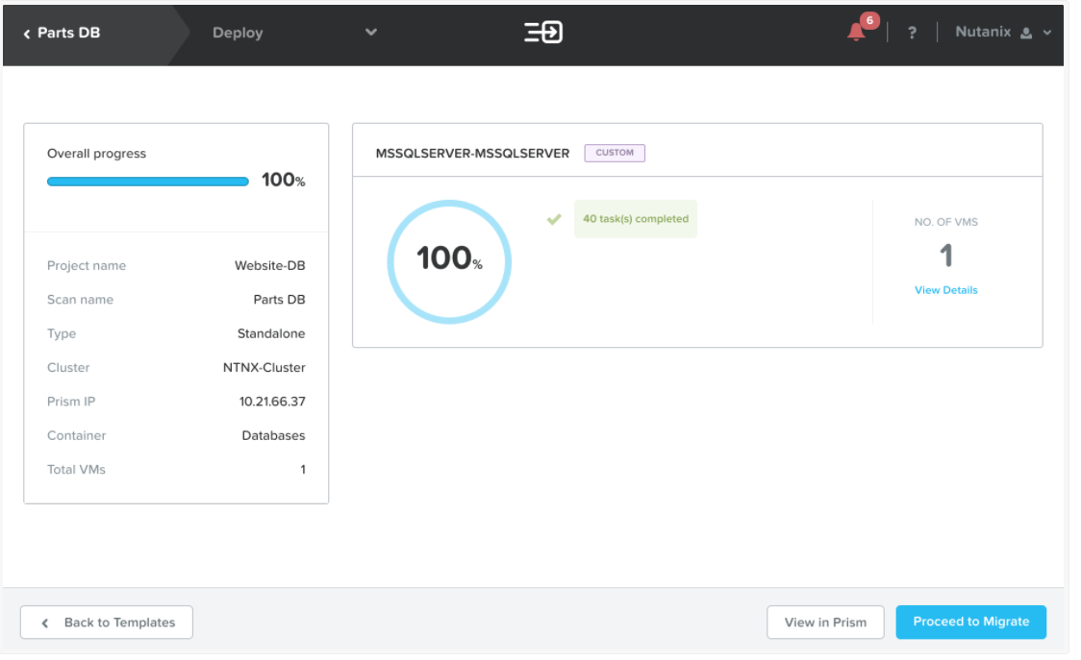
Tools XTRACT

Slide 6
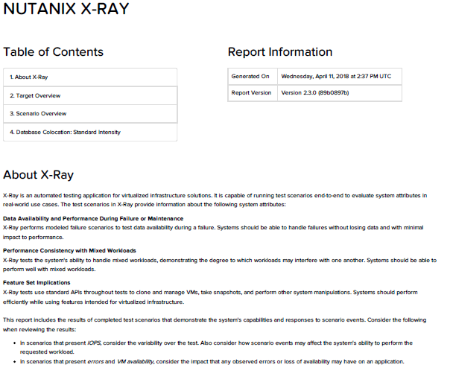
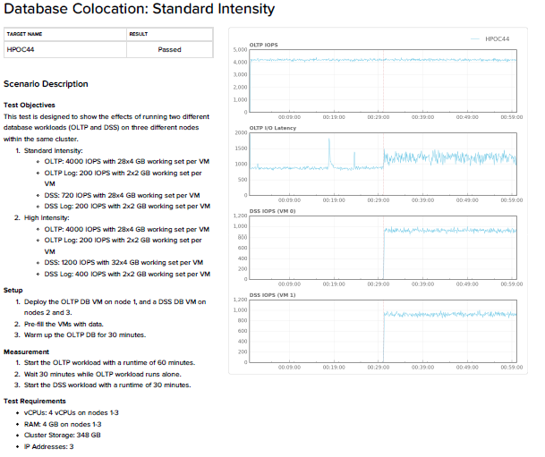
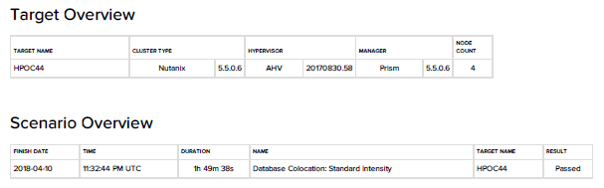
Tools XRAY

Slide 7
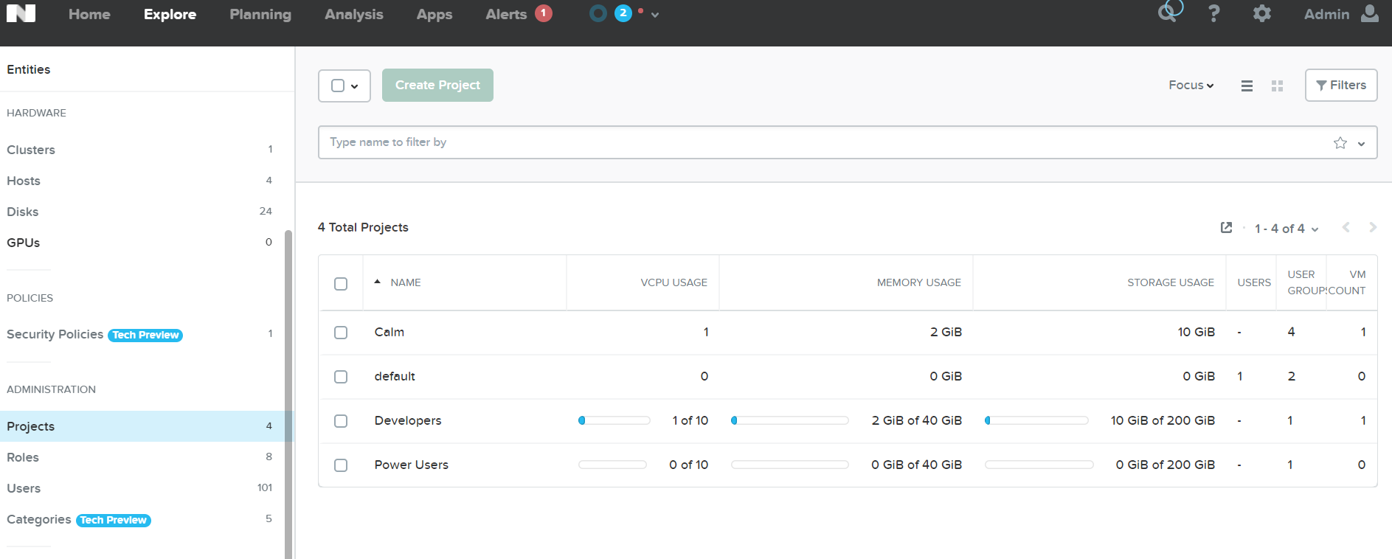
Tools SSP

Slide 8
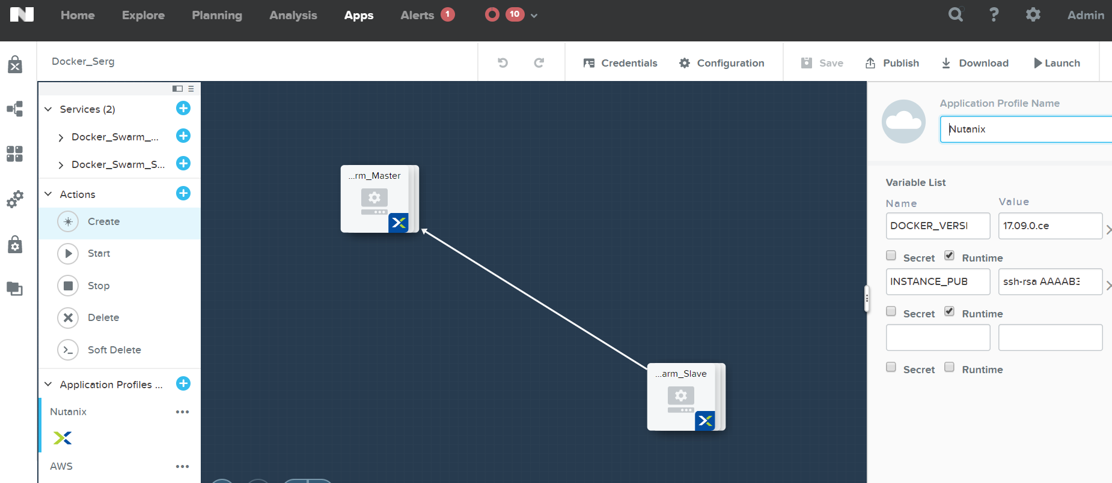
Tools Calm

Slide 9
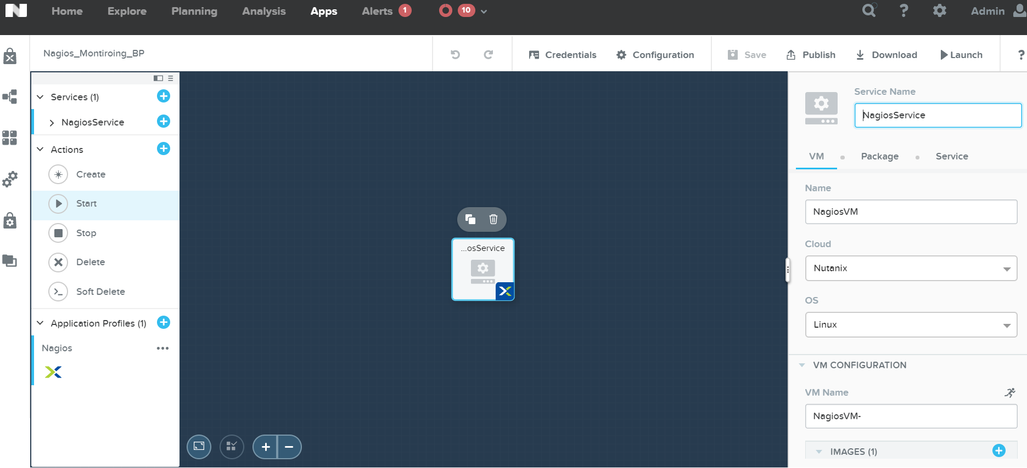
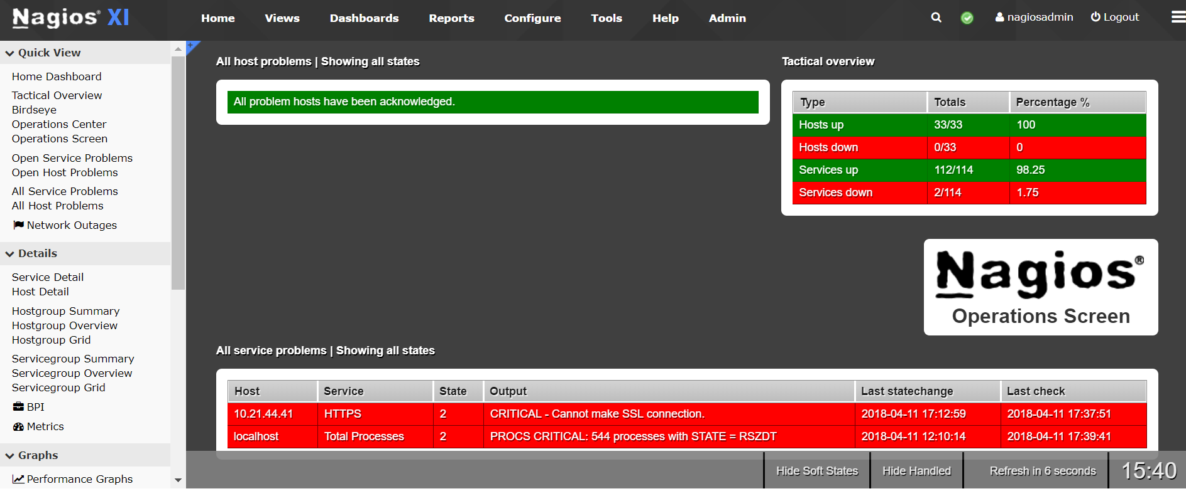
Tools Nagios

Slide 10
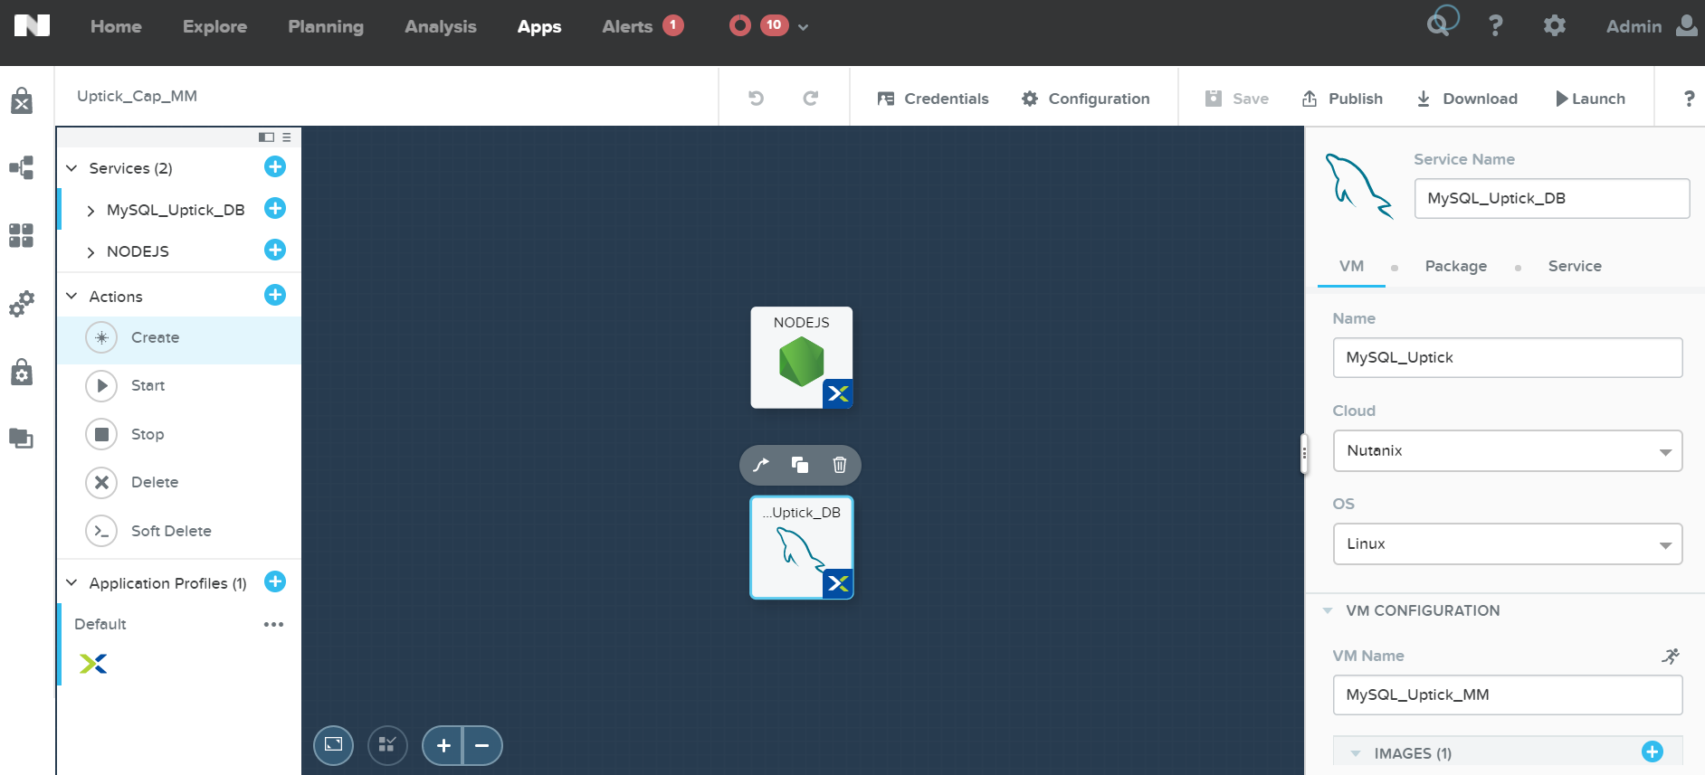
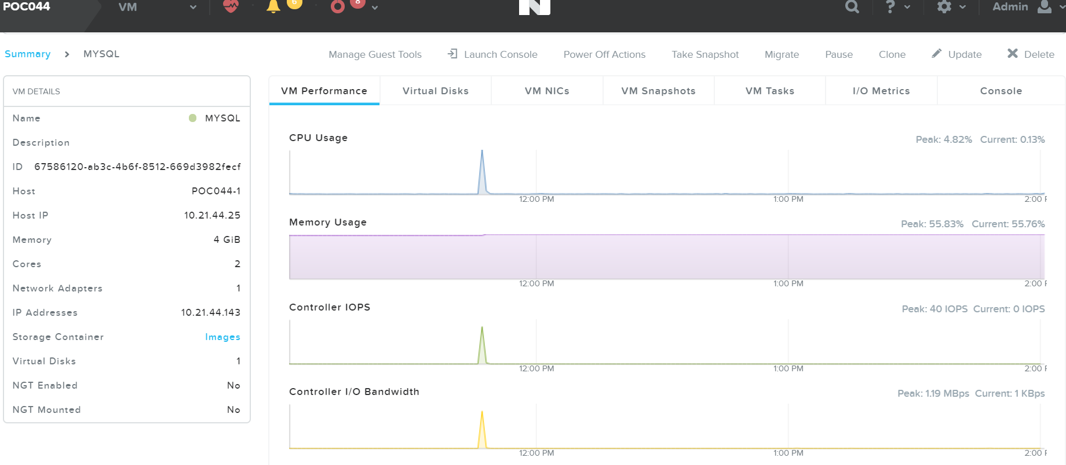
Tools MySQL

Slide 11
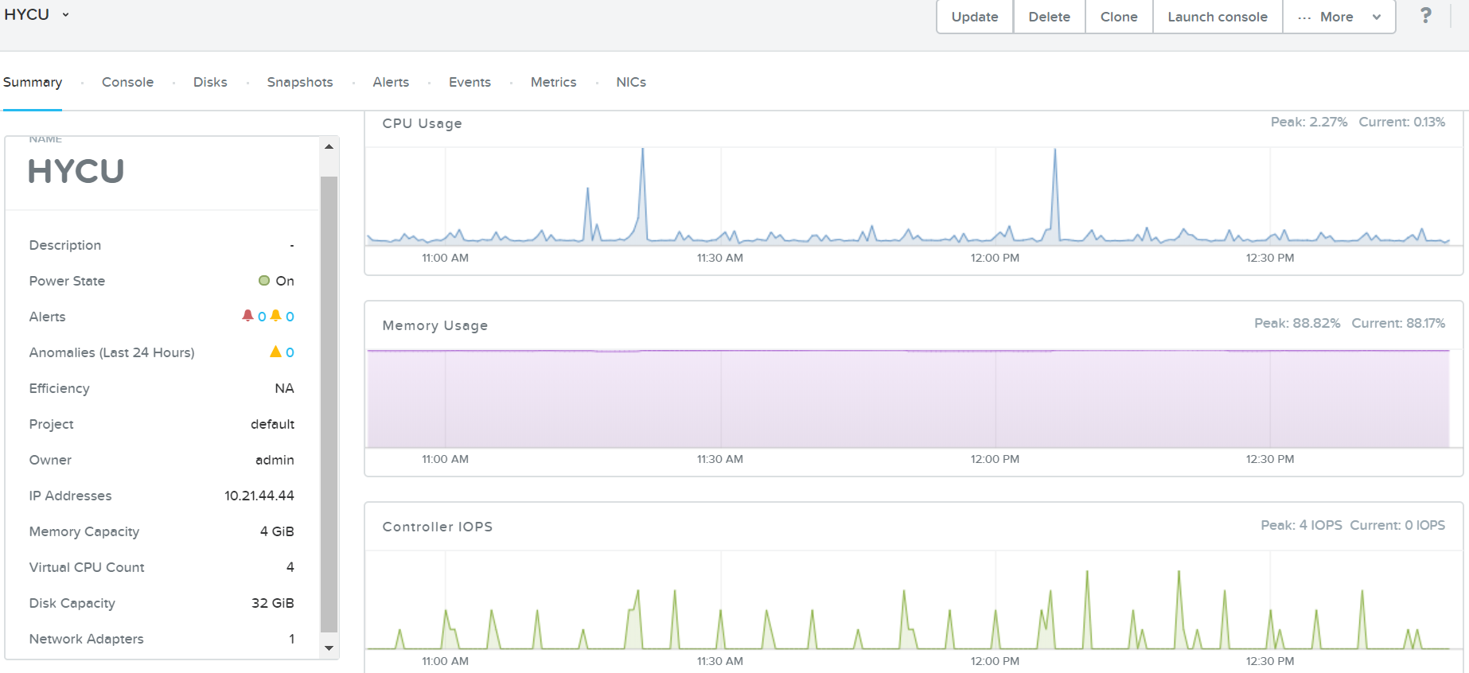
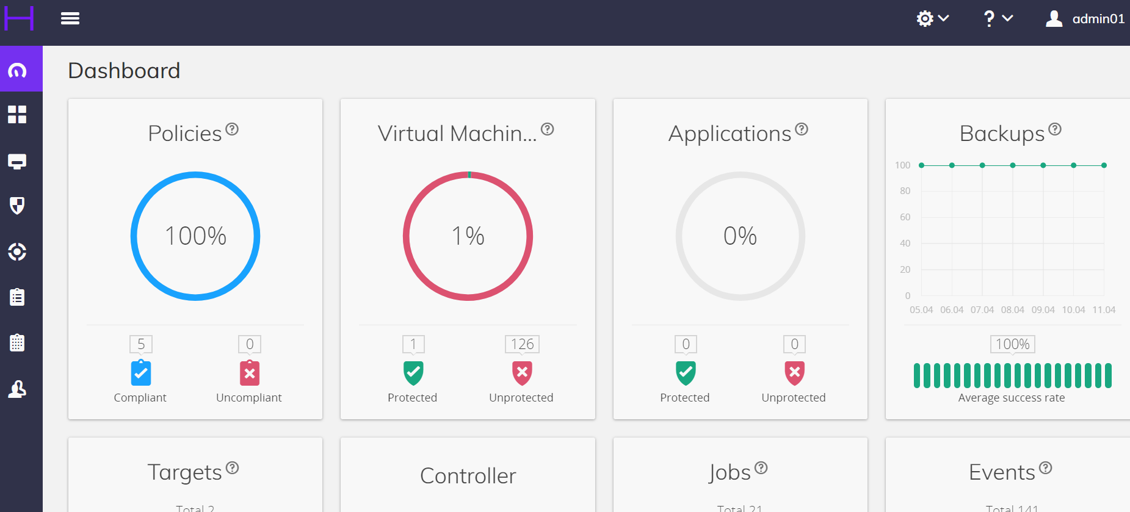
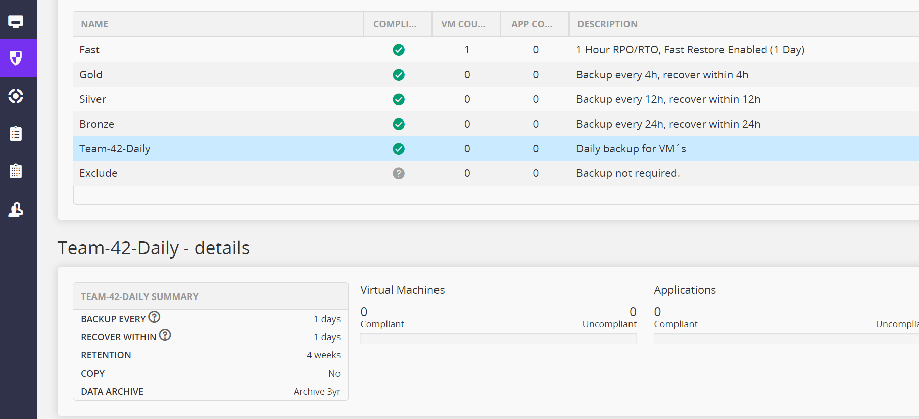
Tools HYCU

Slide 12
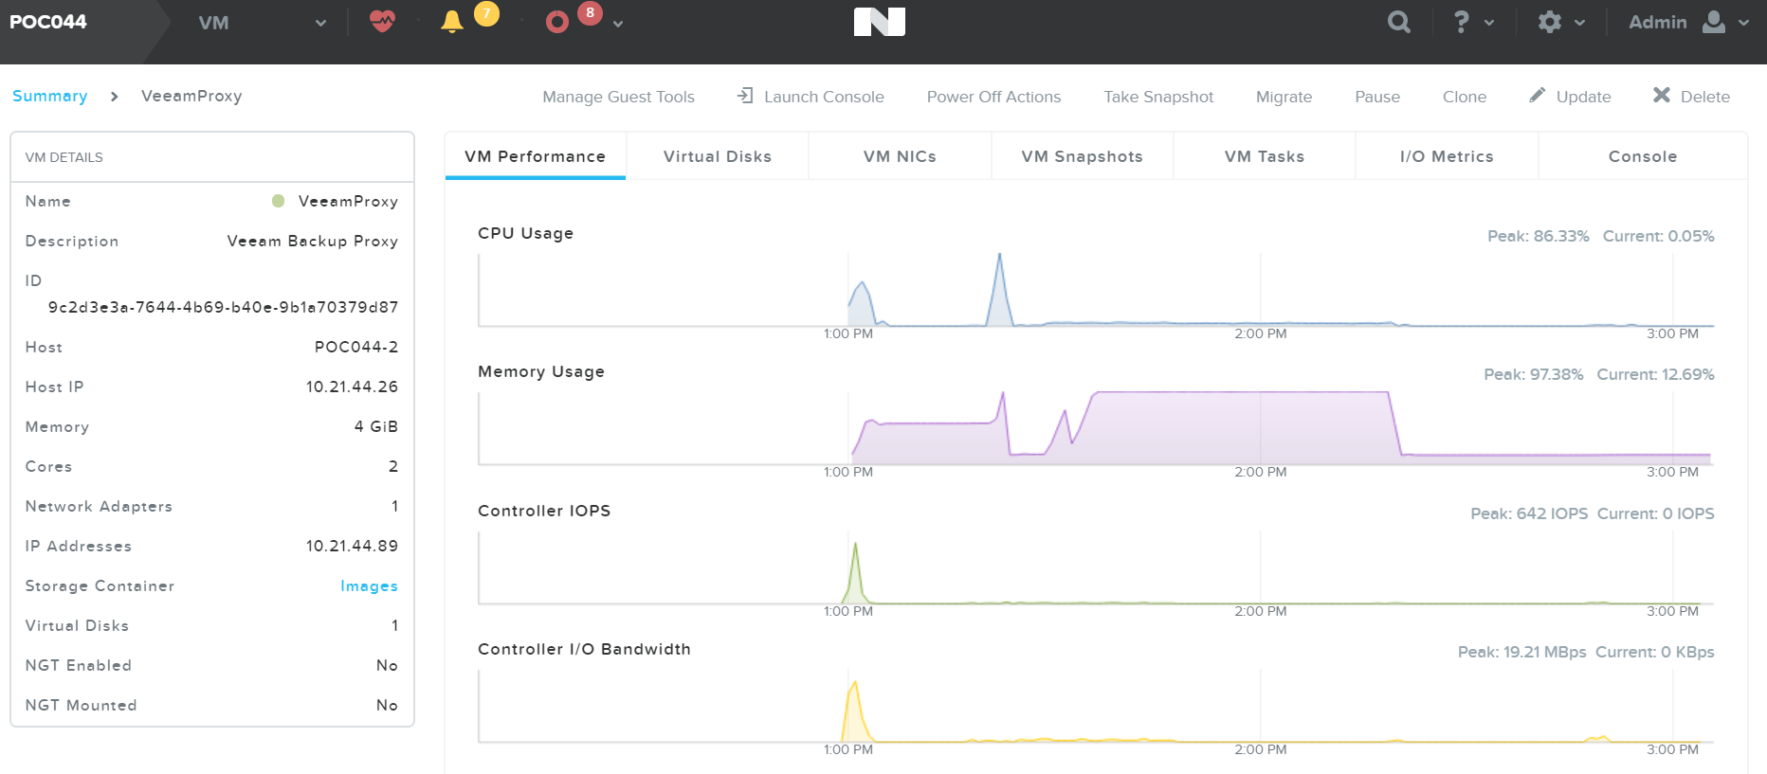
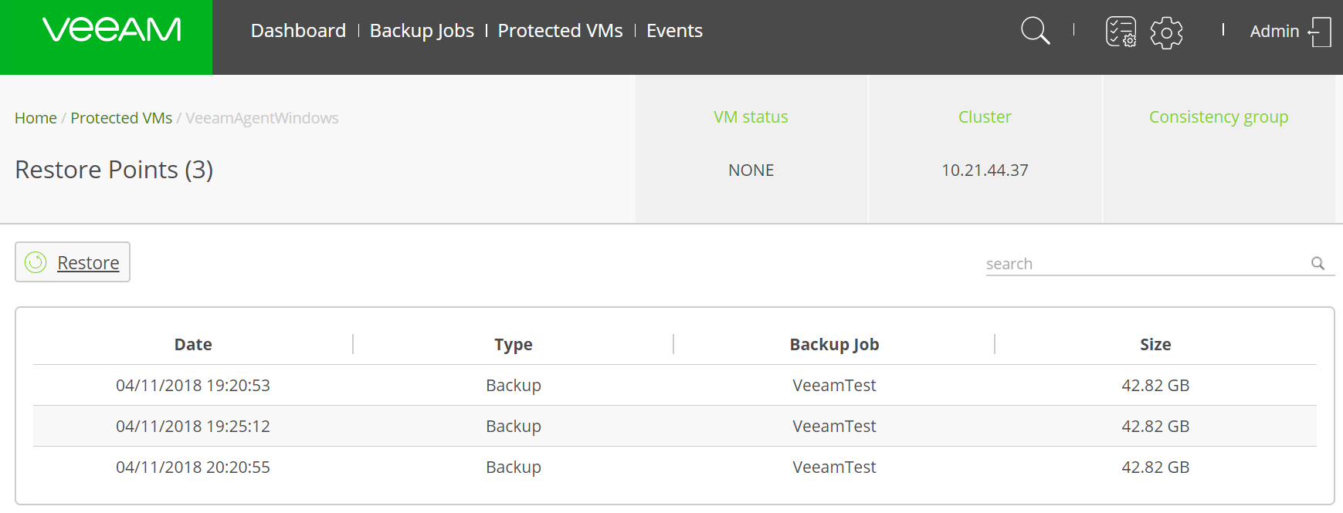
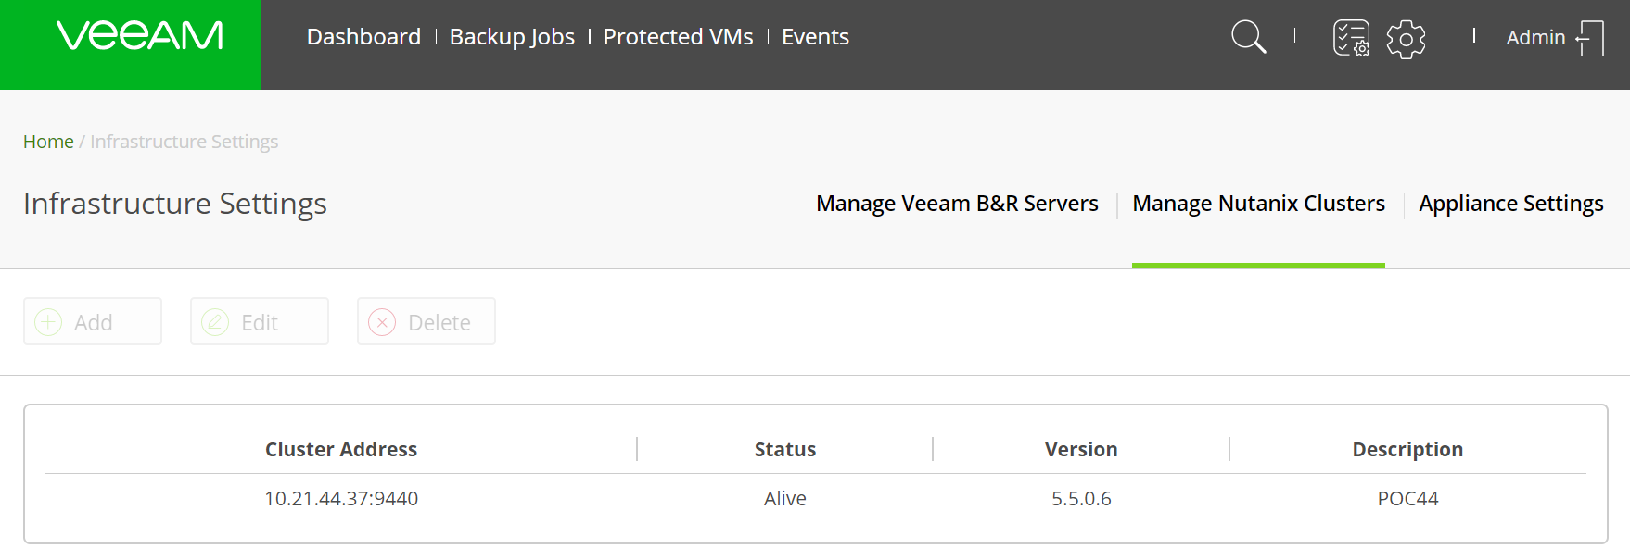
Tools Veeam

Slide 13
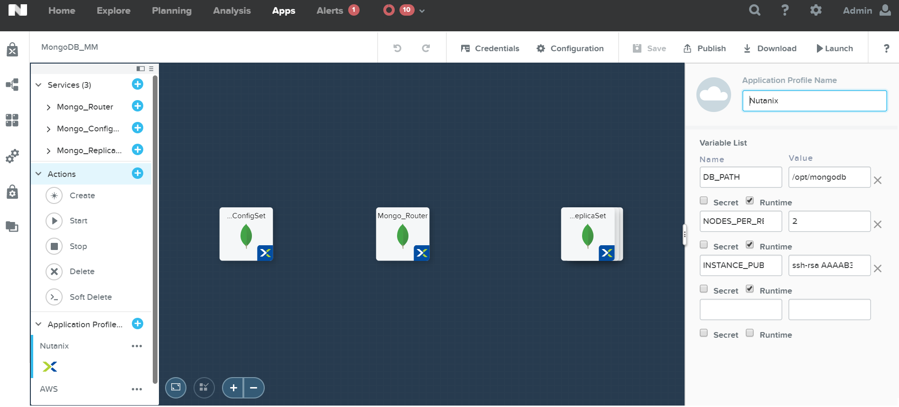
Tools MongoDB

Slide 14
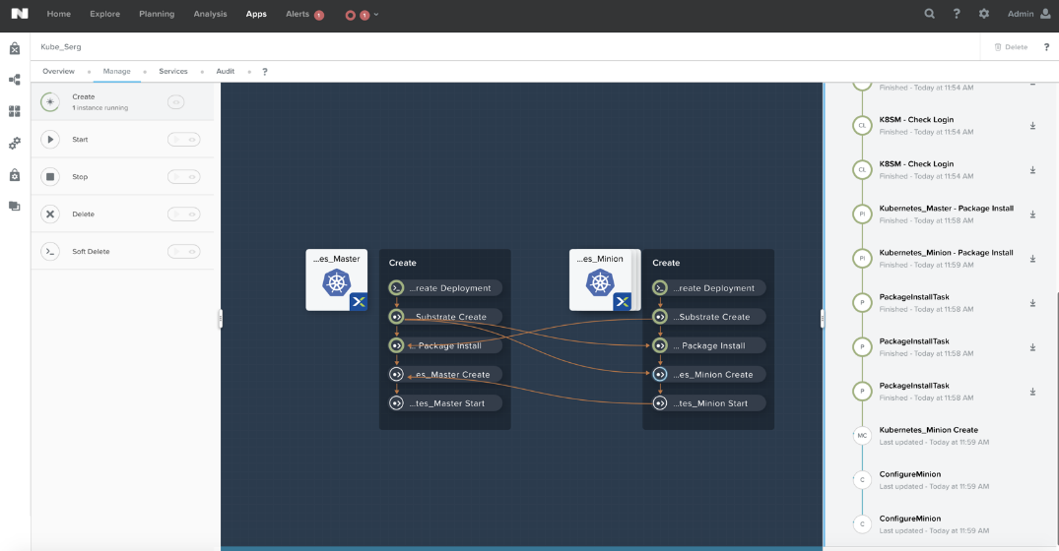
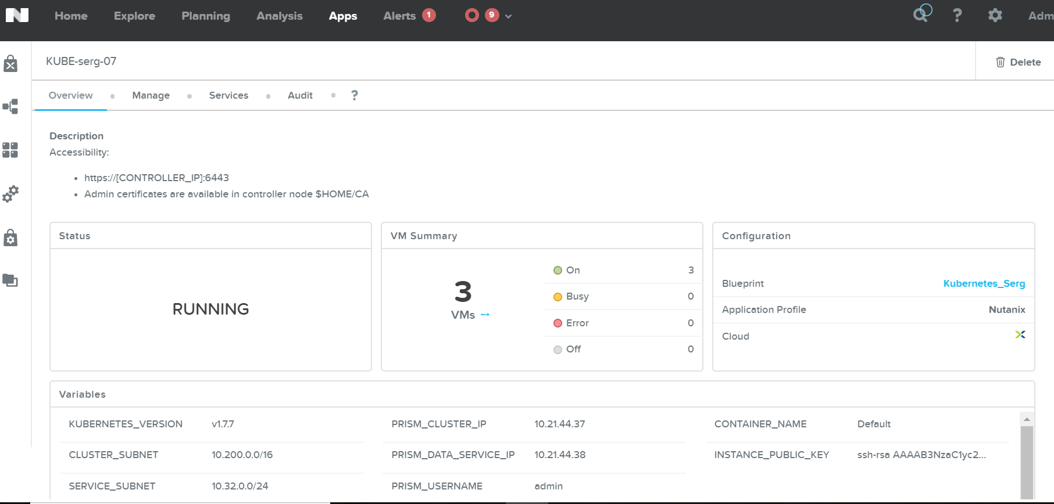
Tools Kubernetes

Slide 15
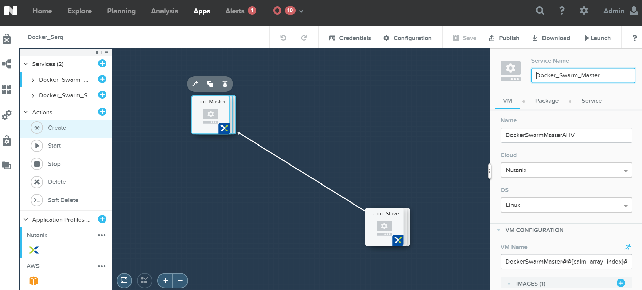
Tools Docker

Slide 16
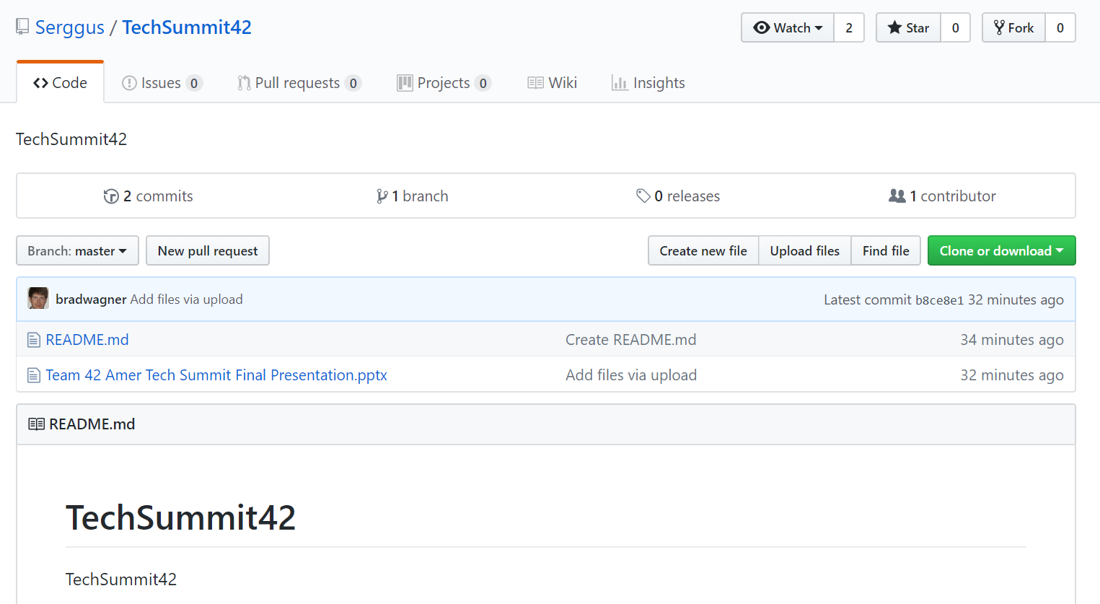
Tools GitHub
Uptick Application – GitHub Link:
https://github.com/Serggus/TechSummit42.git

Slide 17
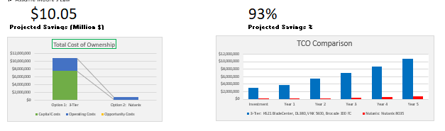
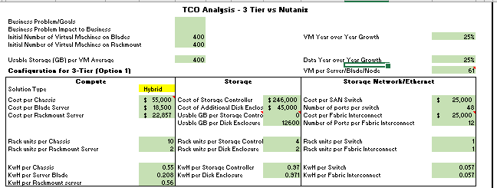
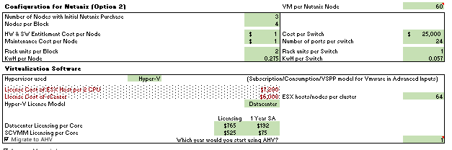
TCO Calculations

Slide 18
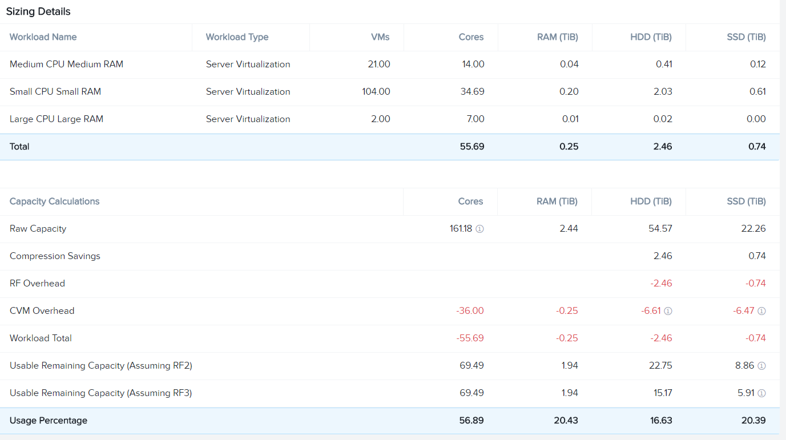
Solution Sizing Workloads

Slide 19
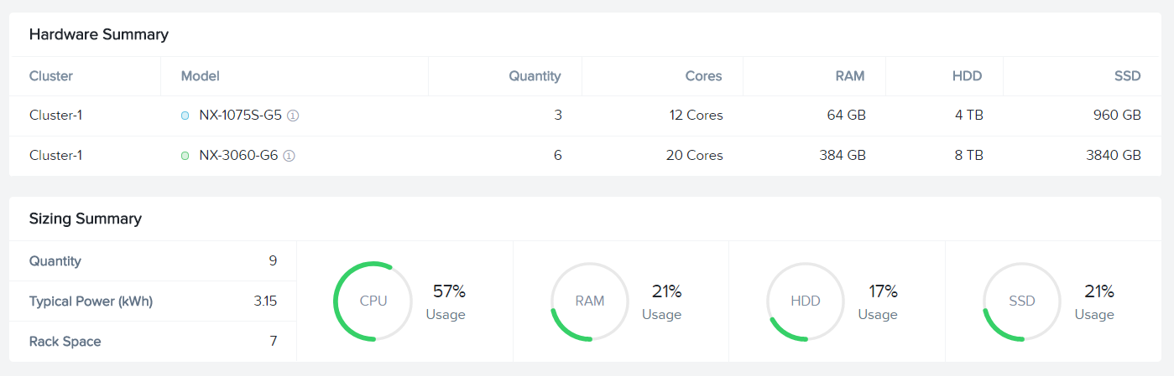
Solution Sizing Results

Slide 20
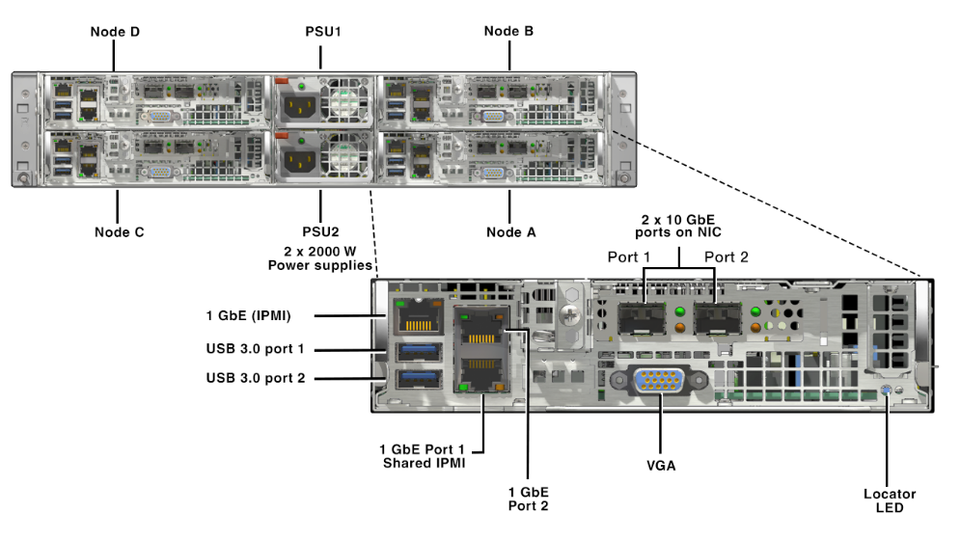
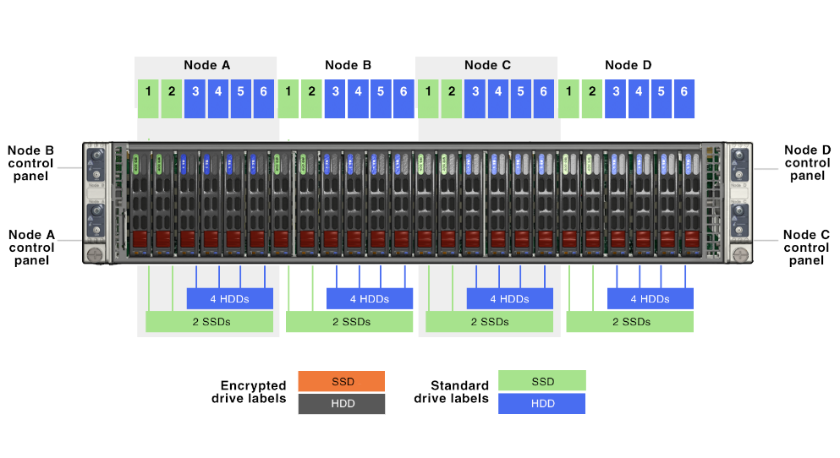
Proposed Cluster Physical Overview
BACK
FRONT
CLUSTER OVERVIEW
NX-3460-G6 NODE OVERVIEW

